Slide 1

EDUMUN 2015
Opening
Speeches

Slide 2

Learning Targets
By the end of this hour, you should be able to:
Formulate an opinion on a topic based on research and critical thinking
Effectively write a clear and concise opening speech
Present yourself as researched, confident, and smart

Slide 3

Seminar Overview
Introductions
Research
Research Activity
Organization
Presentation
Opening Speech Activity
Be Sure to:
Take notes
Ask questions at the ends of slides or during activities

Slide 4
Introductions
Why do a speech at all?
Introduces your country’s position to potential allies
Can impress the dais if done well
Might as well – the more practice, the better!
Application
Always prepare your speech – don’t wing it!
Start confidently – more on that later
How to begin your speech
Thank the audience and the dais
“Thank you, fellow delegates and honorable dais”
“Esteemed delegates and honorable dais, thank you”

Slide 5
Research
Effective Research
30-45 minutes should be more than enough, do not overdo it
It’s OK to start with Wikipedia, but try to move on to academic sites and actual UN documents
Summary
Keep in mind your purpose
Use your research effectively
Be Confident!
How to Utilize Your Research
Present facts that support your position – now is not the time for rebuttals!
Find interesting facts and quotes to incorporate (for opening speeches and speeches in general
Keep it vague
No one wants to hear about a girl named Janika in Ethiopia who fought to get a well for her village – not yet, at least

Slide 6
Time: 15 minutes
Research Activity
Pair up! We’re going to practice introductions and how to incorporate research into an opening speech.
Activity Steps
Decide sides (cats v. dogs) – try to avoid personal bias!
Using the infographics on the next slide and any other facts you may know, develop an argument that supports your position.
Slap an introduction on that argument, and you’ve got yourself a working opening speech!
After 10 minutes, we’ll hear a few speeches and focus on what they did well and what they could improve.

Slide 7
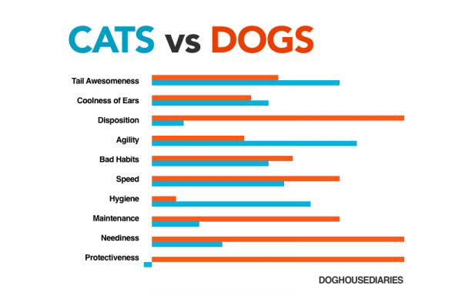
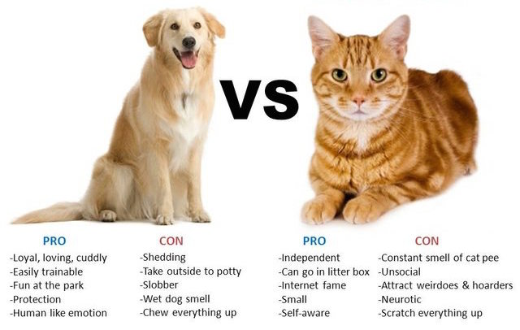
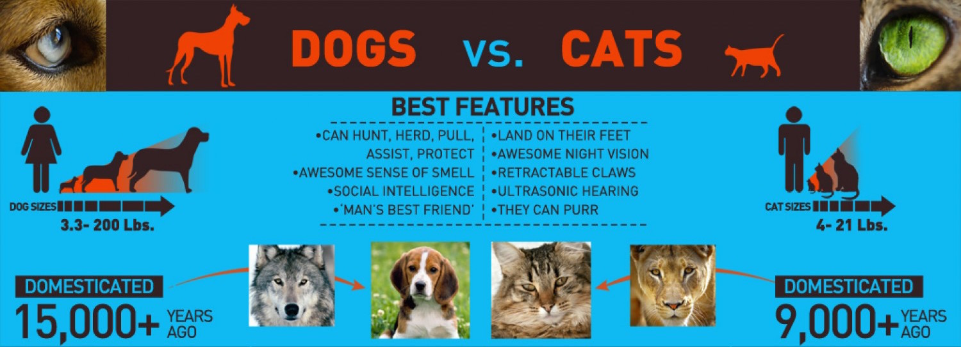
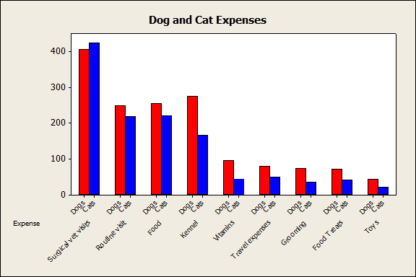
Notes:
Picture Citations: (clockwise, starting with top left)
“Cats vs. Dogs: Visual.” Best-Infographics.com. 30 Apr 2015. Web. 4 Aug 2015.
“Debate 2012: Cat V Dog.” CJ’s Blog, 93.7 KLBJ FM. 17 Oct 2012. Web. 4 Aug 2015.
Stats Cat. “A Look at Pet Ownership Numbers with the Stats Cat.” The Minitab Blog. 21 Sep 2012. Web. 4 Aug 2015.
Vanderveen, Ben. “Dogs vs. Cats.” Visually. 27 Mar 2012. Web. 4 Aug 2015.

Slide 8
Organization
The rest of the speech
2-3 paragraphs MAXIMUM
Paint in broad strokes – state your stances on each topic, and ideas for solutions
Lift heavily from your position paper
Conclusion
End with a bang, not a whimper – this requires planning!
Ex. “It is of grave importance that we solve ______, which is why we should ______ and continue exploring solutions.”
Yield your time to the chair
Make sure to include:
Your country’s name (duh) and position on the topic
Which topic you would like to discuss first and why it is important to your country
Potential solutions to explore

Slide 9

Presentation
Why
Show off your research!
Deliver your argument clearly and confidently
Optional Picture
How
Shake off those stage fright jitters (whichever method works best for you)
Eye contact, hand gestures – DO NOT JUST READ YOUR SPEECH
Notes:
Murden, Dawn. “Should you use notes when giving a speech?” Talk Business. 28 Aug 2013. Web. 4 Aug 2015.

Slide 10
Time: 20 minutes
Final Activity
In order to prepare for the Capstone Project, we’ll be preparing opening speeches to set the agenda!
Activity Steps
Start with an introduction
Using “research” (aka your personal knowledge) write the body of your opening speech
Conclude the speech by emphatically answering the question
Good luck!

Slide 11
Time: 20 minutes
Potential Topics:
Which high school at EDUMUN is the best?
Which country has the best food?
Good luck!

Slide 12
Reflection
Formulate an opinion
You learned how to incorporate research into your opening speech.
Effectively write
You learned how to begin and organize an effective body for your speech.
Present yourself
You learned how to achieve a smooth, confident delivery.

Slide 13
Questions?

Slide 14
EDUMUN 2015
Thank you for your time!

